Slide 1



Hadoop Tutorial
Rack Awareness in Hadoop

Slide 2
Rack Awareness
Rack : is the collection of machines which are physically located in a single data-center connected through traditional network design and top of rack switching mechanism.
In Hadoop, Rack is a physical collection of Nodes (slave machines) put together at a single location for data storage.
DATA CENTER
Rack-1
Rack-2
Rack-N
Node-1
Node-1
Node-1
Node-2
Node-2
Node-2
Node-3
Node-3
Node-3
Node-4
Node-4
Node-4

Slide 3
Rack Awareness
Rack Awareness : the concept that chooses closer DataNodes while storing the data blocks based on the rack information, maintained by NameNode in the form of Rack-Id’s, is called Rack Awareness in Hadoop
Rack awareness is having the knowledge of Cluster topology or more specifically how the different data nodes are distributed across the racks of a Hadoop cluster.

Slide 4
Rack Awareness
Placement of replica is critical for ensuring high reliability and Fault-tolerance of HDFS.
Optimizing replica placement via rack awareness is a distinguished feature of HDFS.
Replication in multiple racks in HDFS is done using a policy as follows:
Replica Placement Policy : “No more than one replica is placed on one node. And no more than two replicas are placed on the same rack.”

Slide 5

When the client is ready to load a file into the cluster, the content of the file will be divided into blocks(each Block size 128 MB) Then client consults the Name node and gets the address of data nodes for the default 3 replication copies for every block. While placing in the data nodes, The key rule followed is "for every block of data, two copies will exist in one rack, third copy in the different rack". This rule is called as "Replica Placement Policy".
Block A :
Block B :
Block C :
Rack-1
Rack-2
Rack-3
Node-1
Node-2
Node-3
Node-4

Slide 6
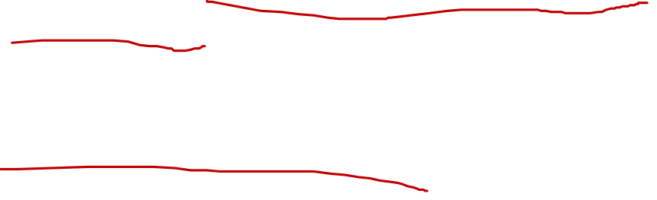
Rack Awareness: Example
When a new block is created: The First replica is placed on the local node. The Second one is placed on a different rack and the third one is placed on a different node at the local rack.
When re-replicating a block, if the number of an existing replica is one, place the second one on the different rack. If the number of an existing replica is two and if the two existing replicas are on the same rack, the third replica is placed on a different rack.
One simple way to store data block replicas could be each one on the separate Rack, however this could increase the latency of Write operations.
So the Replication policy is designed in such a way that it does not impact on data reliability and availability guarantee. At the same time, it does reduce the aggregate network bandwidth used when reading data since a block replica is placed in only two unique racks rather than three.

Slide 7
Rack Awareness: Performance
Faster replication operation: Since the replicas are placed within the same rack it would use higher bandwidth and lower latency hence making it faster.
If YARN is unable to create a container in the same data node where the queried data is located it would try to create the container in a data node within the same rack.
This would be more performant because of the higher bandwidth and lower latency of the data nodes inside the same rack.

Slide 8

Advantage
Minimize the writing cost and Maximize read speed – Rack awareness places read/write requests to replicas on the same or nearby rack. Thus minimizing writing cost and maximizing reading speed.
Provide maximize network bandwidth and low latency – Rack awareness maximizes network bandwidth by blocks transfer within a rack.
It assigns tasks to nodes that are ‘closer’ to their data in terms of network topology i.e on the same RACK. This is particularly beneficial in cases where tasks cannot be assigned to nodes where their data is stored locally.
Data protection against rack failure – By default, the namenode assigns 2nd & 3rd replicas of a block to nodes in a rack different from the first replica. This provides data protection even against rack failure.

Slide 9
Thanks and do subscribe to my channel

